Slide 1

Fifa World Cup Predictions
Saahil Deshpande, Yin Tang and Ircilia Inacio

Slide 2
Introduction
Sports news anchors around the world speculate about team’s performances
FIFA World Cup was founded in 1930
To infer whether the distance travelled by a team would be a significant factor in the outcome of a match
To propose a model that can accurately predict whether the home team in a match would win, lose or whether there would be a tie

Slide 3
Data
International Soccer data from 1990 to 2017 of 14313 matches
Data contains 5 categorical variables : team’s names, location and final result of the match
7 continuous variables: latitude and longitude of home and away team, total market value
2 Discrete variables : home team and away team scores
1 Date variable

Slide 4
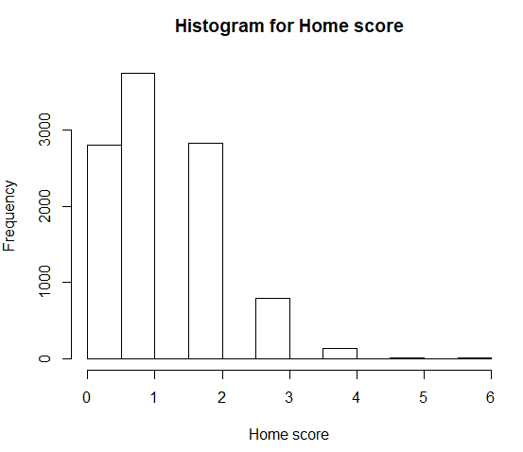
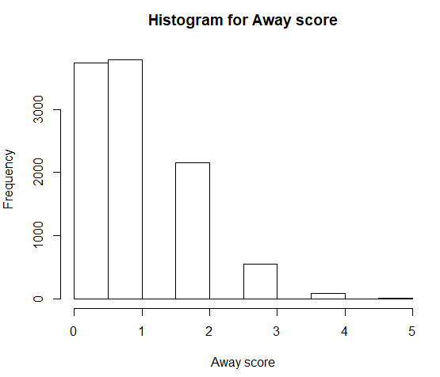
Data cleaning
Dropped teams that played only in 1 tournament and never again
Dropped scores with over 3 goals
Combined teams with 2 and 3 as two goals or more
Removed observations before the year 2000

Slide 5
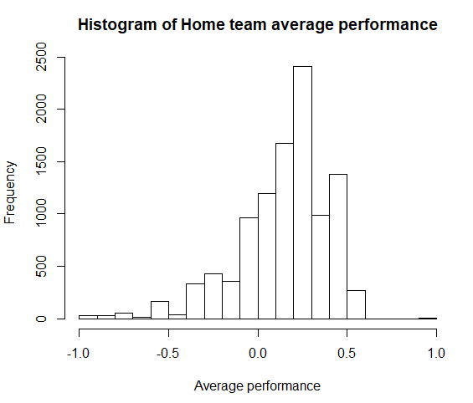
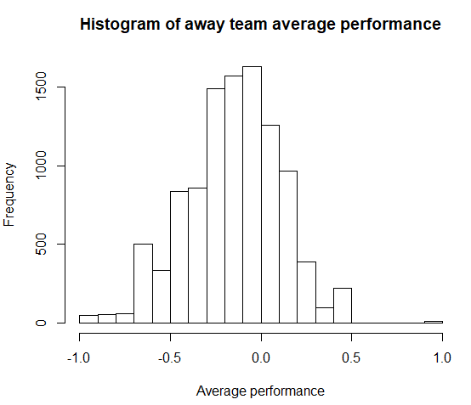
Feature Engineering
Standardize the result of each match
Result = home_team_score - away_team_score
Extreme values
Factor the result to 3 levels (win, tie or lose)
220 levels for home team and away teams
Category data
Group the teams by their past average performance (-1, 1)
Most of the home teams have performance between (0, .5)
Most of the home teams have performance around 0
Stratified each group

Slide 6
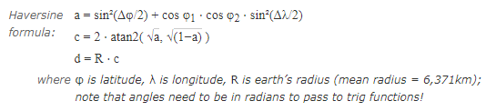
Feature Engineering
220 levels for home team and away teams
One-hot encoding all categorical variables (team, tournament)
Large sparse matrix with 500+ features
Predict performance for each team
Large dataset, more noise
Calculate linear distance by longitude and latitude
‘haversine’ formula

Slide 7
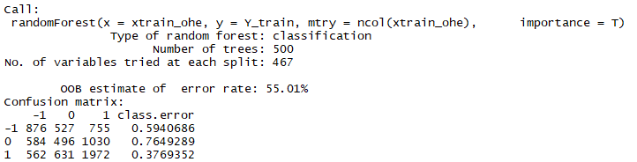
Bagging (bootstrap aggregating)
Reduce variance & overfitting
Result ~ home team + away team + tournament + distance + month
The method is with 500 trees and all columns as entry
‘Tie’ is most difficult to predict; ‘win’ is relatively accurate.

Slide 8
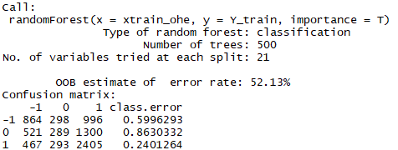
Random Forest
Change the number of entries or trees
Out-of-bag error improved by 3%
‘Tie’ is most difficult to predict; ‘win’ is relatively accurate

Slide 9
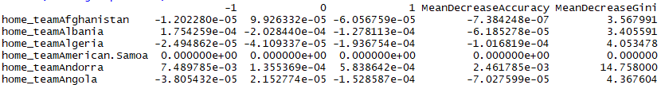
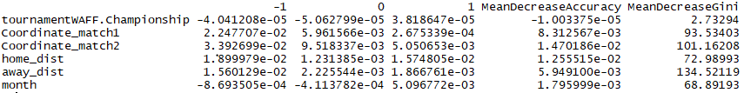
Random Forest
Most influential variables:
Least influential variables:

Slide 10
Boosting
Boosting is a method applied for cases where we have low variance and high bias.
Home team and Away team groups were used
Model was trained with 1000 trees and a learning rate of 0.01
Classification was done using the multinomial distribution
Cross entropy loss was used to validate the best model.

Slide 11
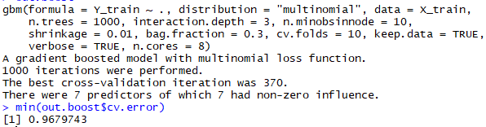
Boosting
A 10-fold cross validation was used to estimate the test error.

Slide 12
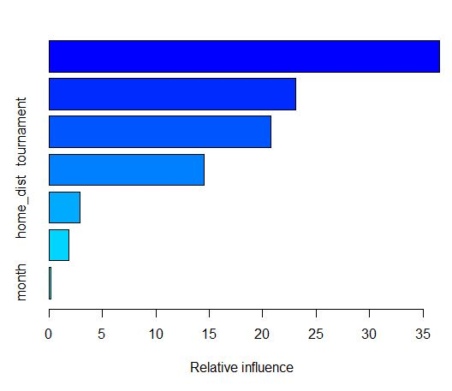
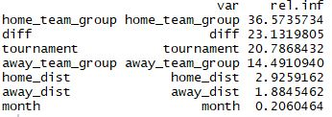
Boosting

Slide 13
Neural Networks
We tried building a wide and deep neural network for classification purposes.
The categorical variables were one hot encoded and given as inputs.
The numeric variables were normalized and given as inputs.
The two input layers were combined to create a single input layer.
A couple of dense layers are added with 100 hidden units and ReLU activation

Slide 14
Neural Networks
The final layer is another dense layer with only 3 hidden units, one for each type of response
The response variable is also one hot encoded
The model runs for 1000 iterations, updating the weights to get better accuracy.
The model splits the data into training and test set for validation.

Slide 15
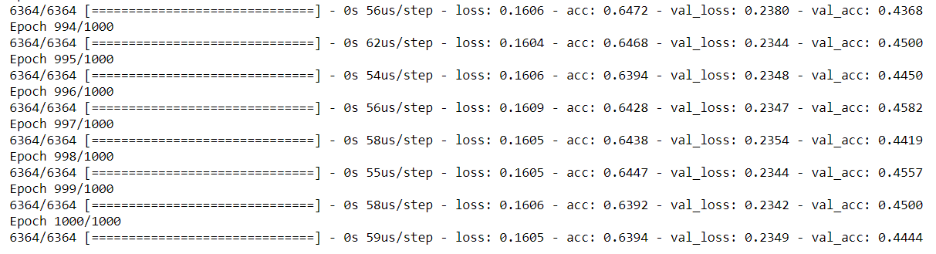
Neural Networks

Slide 16
Results: Effect of travel distance
Random forest, Bagging and boosting, all indicated that the most important feature in estimating the result of the match was the home team and the away team.
Distance travelled by the home team and the away team are among the lesser significant predictors

Slide 17
Results: Predictions
Boosting provides the least cross validation error from all models and we will be using this model to make 2018 world cup predictions.
The model provides the probability for observing every class from the response variable
We use this probability to not only find the result of the match but also to predict the number of goals scored by the home team.

Slide 18
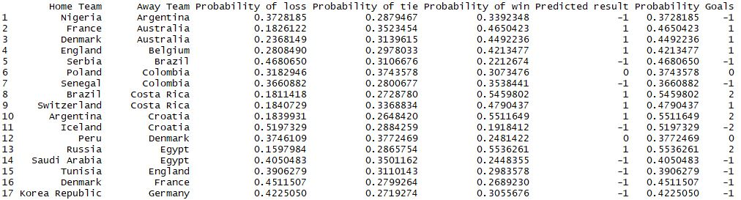
Results: Predictions

Slide 19
Suggestions to improve model
There are a lot of confounding variables which affect the result of a match
The model depends majorly on the name of the home and away team

Slide 20
Conclusion
Travel distance for the teams is not a major factor in estimating the result of the match
The model built for prediction has a high misclassification rate and other confounding variables should be considered for getting better predictions

